Slide 1
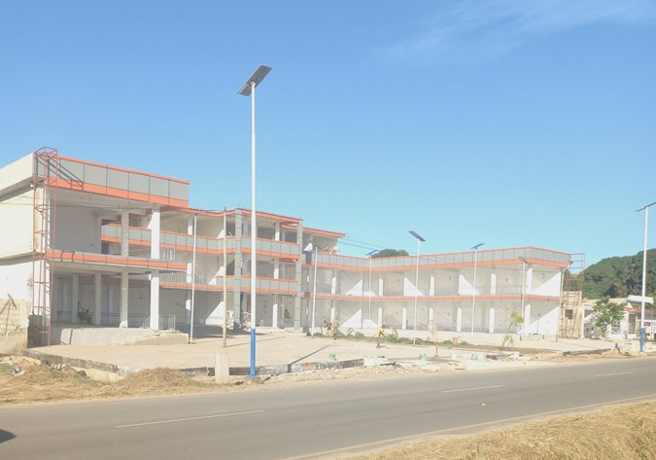
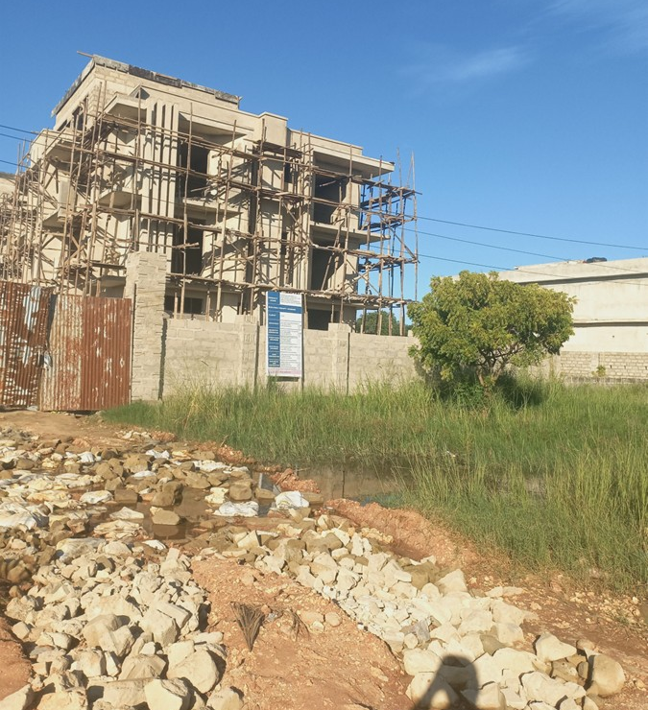
Heightened Risks in Investing in Real Estate in Developing Countries growing out of market failure and institutional lapses
Prepared for and Presented at the AREPTA AGM, Midland Hotel, Dodoma, 14-15 May 2026
J.M. Lusugga Kironde,
Prof. Land and Urban Economics & Policy,
FRV, Certified Financial Educator
Lead Consultant: TKA Company Limited
lusuggakironde@gmail.com

Slide 2
Introduction
Real Estate is a popular destination for investment, whether one invests for income earning, value incrementation, or portfolio diversification
After all it is argued, most rich personalities have a deep foot in real estate
In developing countries, due, in part, to the narrow choice of investment avenues, real estate is a major outlet of investment money
Owning a house, and/or owning investment properties is a dream of all and sundry in developing countries
But, like is the case in all investment, real estate carries risks, which are, in some respects, heightened in developing countries

Slide 3
Real Estate, investment and Saving
Recap: Real Estate comprises of land plus developments on land
Various Forms: Residential, commercial, industrial, mixed use, special real estate, agricultural, land
Investment: Allocation of resources (mainly money) into assets, projects, or financial instruments with the expectation of generating income, profit, or appreciation in value over a future period. It involves putting capital to work to grow wealth, accepting a level of risk for potential returns
Saving vs Investing: Saving is keeping money safe (low risk/liquidity) for short-term needs, whereas investing involves higher risk to earn income or grow value over time.

Slide 4
Significance of Real Estate in the Tanzanian economy
The way the GDP is presented, both Construction Sector and Real Estate Activities can be considered as being part of the GDP
Construction sector: the building of residential and commercial properties, roads, bridges, and other infrastructure, accounted for 12.8% of Tanzania’s GDP in 2024.
Real Estate Activities Sector: This category, which includes buying, selling, and renting properties, as well as appraisal services, contributed 2.7% to GDP in 2024
Urbanisation Rate: 35.76%, driven by real estate developments in unplanned areas covering 60% in urban areas

Slide 5
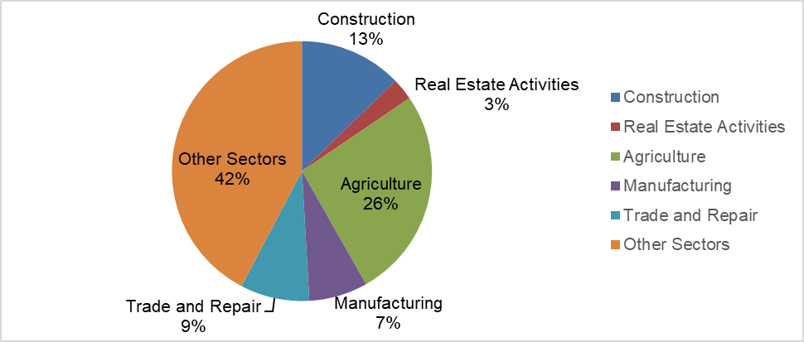
Significance of Real Estate in the Tanzanian economy around 16% of GDP
Real Estate activities include: buying, selling, and renting properties, as well as appraisal services. These contributed 2.7% to GDP in 2024
Add construction = 16%

Slide 6
Advantages of Investing in real estate
Appreciates in value over time
A hedge against inflation compared to other investments
Intrinsic prestige and social value (which sometime may lead to uneconomic investment)
Can be leveraged to expand a particular investment portfolio; and other business
Leverage is the use of debt (borrowed capital) in order to undertake an investment or project. The result is to multiply the potential returns from a project
Valuers can help investors to determine value of their assets to help them expand through leverage

Slide 7
Advantages of Investing in real estate cotd
Can create regular income and cash flow, or even a career
Building equity for the future i.e. As you pay down your mortgage loan or the home's property value rises, you build up equity -- which you can cash in on later
Can be bequeathed to posterity
Portfolio diversification (besides stocks, bonds, other securities, to mitigate risks of losses: Do not put all your eggs in one basket)
Impact the larger community eg improving housing, family stabilization, local tax base, local economy eg employment. As community flourishes, your assets appreciate as well.

Slide 8
Disadvantages of Investing in real estate
Real Estate Market is unpredictable
High cost of acquisition and transaction and maintenance
Inflexibility (Indivisibility) and immobility
Affected in many ways by Location (Externalities)
Net Income may be Negative (income less maintenance cost)
High Vacancy rates may eat into cash flows
Problematic Tenants, some misuse property, arrears, nuisance
Hidden Structural Problems: eg soil, settlement
Low Liquidity, cannot be quickly converted into cash

Slide 9
Concept of heightened risks in real estate
While it is admitted that all investment has its own risks, the concept of heightened risks in developing countries seeks to argue that there are risks in LDCs that may not exist in MDCs or their impact may be limited or temporary
Thus, textbook knowledge based on the US or the UK, needs to be modified to reflect local (adverse) circumstances
When talking of real estate in the US, you may not be worried about (lack of) public infrastructure, development control or weak governance structures
You do not confront a good number of problems faced in LDCs

Slide 10
Market Failure, more serious in LDCs
Real estate economics accepts that government intervention is necessary to address matters of market failure which include:
  Land use planning and development control certainty
  Provision of public goods such as public infrastructure
  Dealing with externalities
  Dealing with information asymmetry and market fuzziness

Slide 11
Land Use Planning and Development Control
Most real estate in a country like Tanzania is developed in informal or unplanned areas. These lack a land use plan and many times even land for public infrastructure
Towns with Up-to-Date Master Plans 26 (2023/24). See number of LGAs.
But master plans are just on paper, they are not adhered to or enforced and are usually overtaken by rapid urban development
Most Tanzanian urban areas (47), are growing without formal planning guidance. This applies also to townships, trade centres
Huge risk to investors

Slide 12
Land Use Planning and Development Control - Administrative areas
SNo | Administrative classification | Number (Mainland)
1. | Regions | 26
2. | Districts | 136
3. | Local government Authorities | 184
4. | Cities | 6
5. | Municipalities | 22
6. | Town Councils | 20
7. | District Councils | 137
8. | Township authorities | 71

Slide 13
Weak Land Use Planning and Development Control
Weak Urban Planning Enforcement: Zoning regulations exist but are weakly, or not at all, enforced.
Developers build outside permitted zones; ignore building regulations
Public authorities lack technical capacity and political will to enforce planning codes.
Results in uncontrolled development, traffic congestion, mixed-use conflicts, and loss of public space.
Corruption may also play a part
Increases risks for real estate investors

Slide 14
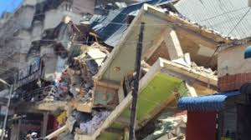
Weak Land Use Planning and Development Control
Collapsed multistorey building in Kariakoo. Non- adherence to building regulations suspected.
The Citizen wrote in November 2013: Kariakoo Multi-story buildings, a time bomb
A four-story commercial building collapsed in Dar es Salaam's bustling Kariakoo market area on Saturday, November 16, 2024, resulting in a tragic death toll of 29 and at least 88 injuries. Investigations ordered

Slide 15
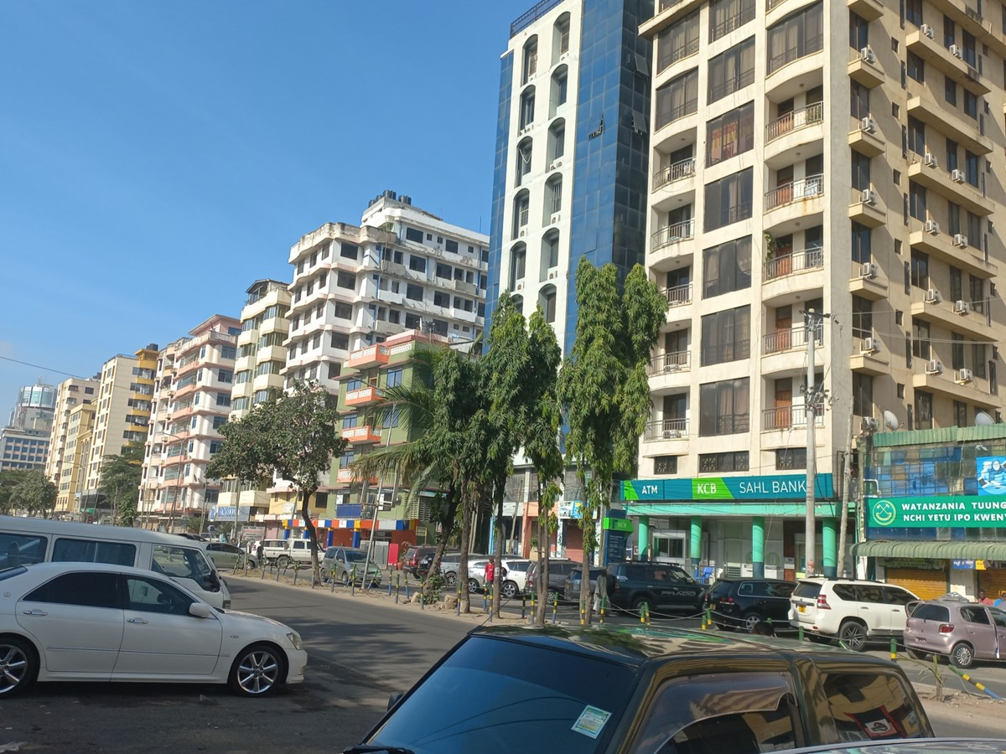
Weak Planning and Development Control
Investors expect certainty in the land use approved for an area
Incompatible land uses, ignoring of set backs and plot ratios increase the risk to real estate
One may invest expecting a certain view of an open space, only to find that the view is blocked, or are turned into a concrete jungle. You build for residences, commercial comesin
Action for global warming resilience eg urban forests, trees, wetlands may all be thwarted
Some of these buildings may not be adhering to building regulations eg plot ratios and set backs.
Kariakoo, Oysterday, Upanga, all going up uncontrollably

Slide 16
Problems with Public Infrastructure
Way back in the 1970s, during the Sites and Services Project, it was decided to cut down on infrastructure, to save on costs: unmade roads and drains, stand water pipes per 50 plots.
This has become the norm even in planned areas: development first, infrastructure later
Most roads are unmade, not to standards, lack important aspects such as drains; water and electricity networks inadequate
Makes it difficult and expensive to develop, maintain real estate

Slide 17
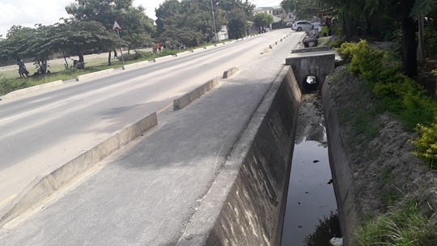
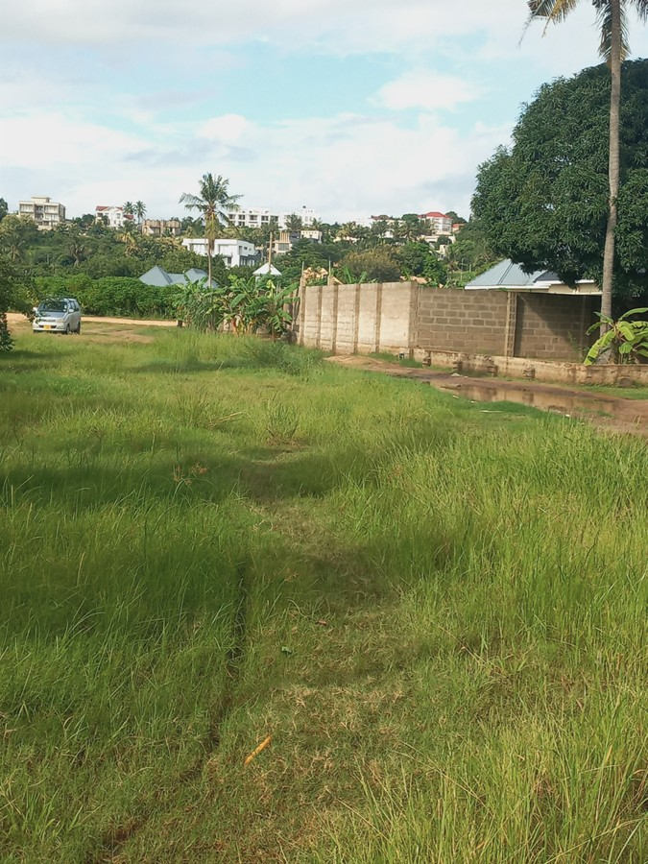
Problems with Public Infrastructure
A “road” in a planned area of Mbweni. Behind the walls, partly hidden, are newly developed residential units, Besides being unkept, the road floods regularly.
High risk for real estate investing
The ideal standards of a road in a planned area: tarmacked, pedestrian walkaway and a drain for surface water transport. Such roads are rare in LDCs.
BUT, uncoordinated infrastructure, such as drains, may solve a problem in one area, cause flooding elsewhere

Slide 18
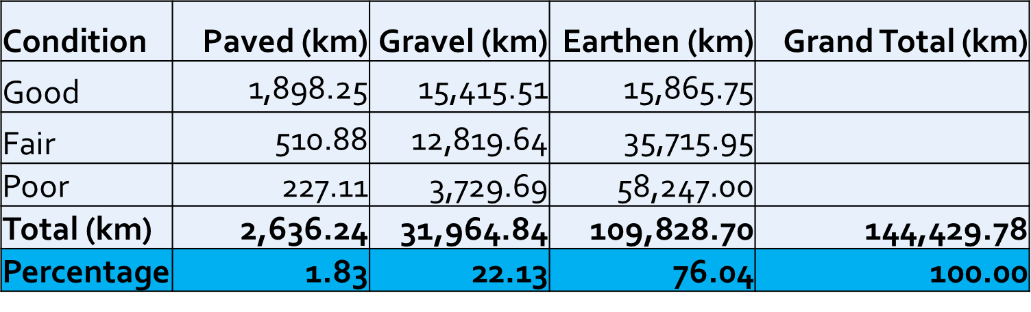
Problems with Public Infrastructure – Status of TARURA Roads, 2022
Please Note: Under 2% of TARURA Roads are paved, and over 76% are earthen, most, over half, in poor condition.
Urban roads, most related to real estate, are under TARURA
TARURA is therefore carrying a heavy burden
BESIDES: There are other roads under the jurisdiction of local governments

Slide 19
Problems with Public Infrastructure water, demand supply, coverage
Water is important for developing real estate and is essential for occupiers
Yet, in many LDCs, there is inadequate water production to meet demand, distribution is skewed, and a lot of water, is lost
DAWASA: Demand of 732 MLD; Production, 558 MLD, creating a deficit of over 170 MLD
Non-revenue water (leaks/theft): 35–40% of production
Network: 7,087 kilometers, serving over 450,000 customers
47.6% of urban buildings have water, i.e under 50% (TBC 2022)
Investors: Buy water (bowsers), water storage; boreholes; all costly

Slide 20
Problems with Public Infrastructure electricity
23.4% of all building in the country, connected to national grid
Connectivity higher in urban areas (52% urban; 11.1% rural)
Dar es Salaam, 76.8%
Despite high connectivity, suburban areas (peripheral districts) can experience lower density access and reliance on older infrastructure or backup sources
Power interruptions frequent
Investors resort to standby generators to ensure uninterrupted supply. Increases cost, risk

Slide 21
Problems with Public Infrastructure sewerage
While in MDCs sewer networks are abundant, the situation is different in LDCs
Sewerage coverage in Dar es Salaam is very low, with only 10–15% of the city's population connected to a formal, centralized sewer network.
Over 70% of residents live in informal settlements relying on on-site sanitation, primarily pit latrines and septic tanks.
High cost of investing in real estate, need septic tanks
Regular costs to empty septic tanks

Slide 22
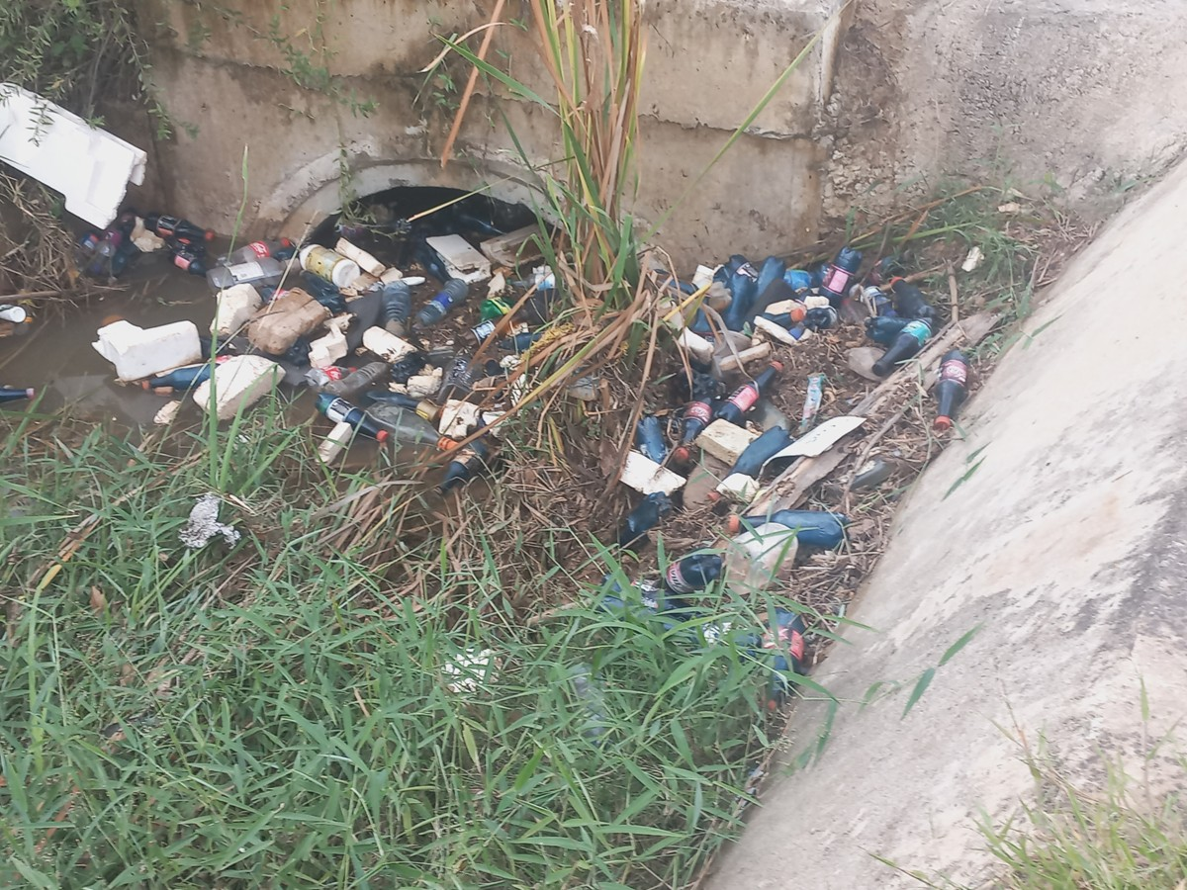
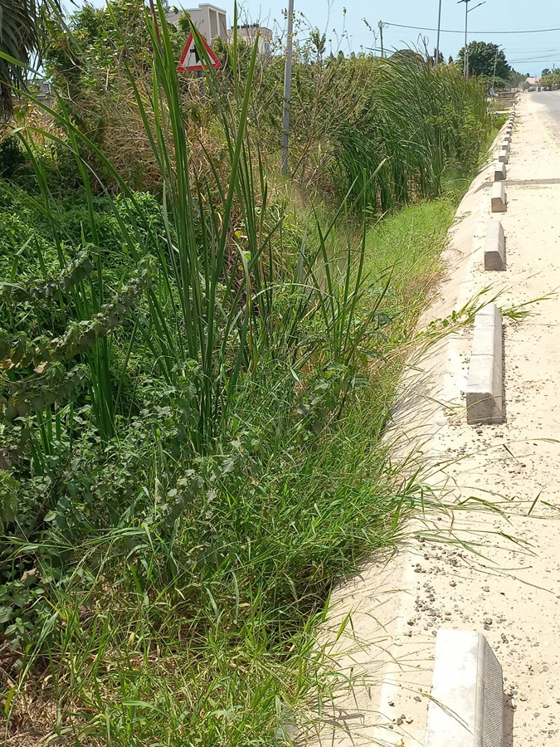
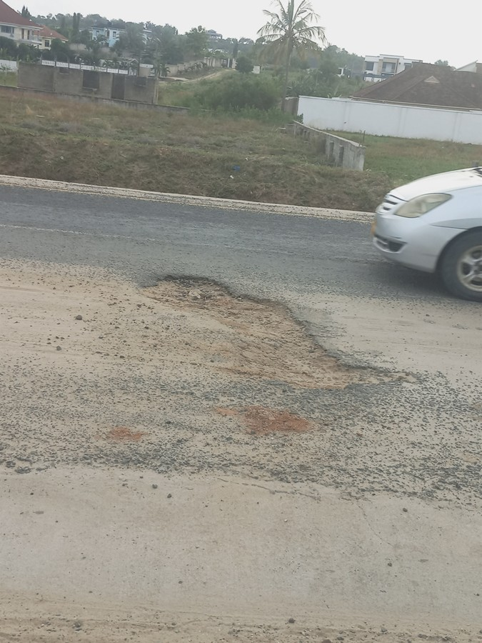
Problems with Public Infrastructure, maintenance
Where infrastructure such as roads, is in place, maintenance is a problem, leading to higher risks for real estate
A small pot hole when unattended to, eats into a large section of the road; Unmaintained drains contribute to flooding

Slide 23
Problems with Public Infrastructure, problems with service providers
Service providers, like those for water and electricity, slow in responding to needs of investors in real estate
Like supplying separate meters (water, electricity) for each tenant in multi-occupied properties
Slow responses when tenants accumulate arrears and services should rightly be disconnected
Landlords have found themselves having to pay water or energy bills, left behind by outgoing tenants, because service providers did not act on time

Slide 24
Information asymmetry and fuzziness
Investors want certainly on allowed land uses for an area and land ownership
In Tanzania only 36% of the land is surveyed, where title can be issued
67.1% of buildings: on unplanned land; only 22.6% on planned land (45.6% in urban areas, 12.8% in rural areas)
Only 10.7% carry certificates of title (Tanz Buildings Census)
Information on ownership and market transactions is thus fuzzy, increasing the risk for investors
Ownership, transactions certain in MDCs

Slide 25
Information asymmetry and fuzziness cotd
Investors usually decide to leap in the dark. Will it pay, will it not pay?
Lots of expensive commercial buildings and apartments, coming up, on a speculative basis
These range from “Frames” for small investors, to malls for large investors
May take years before they are fully utilized, if ever
Capital lying idle
Scanty reference information about (potential) tenants

Slide 26
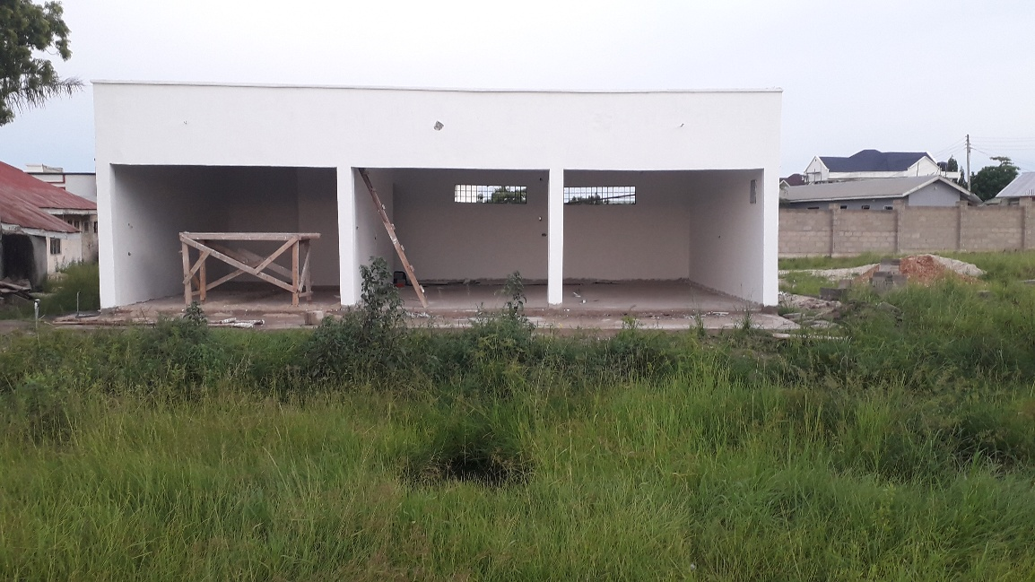
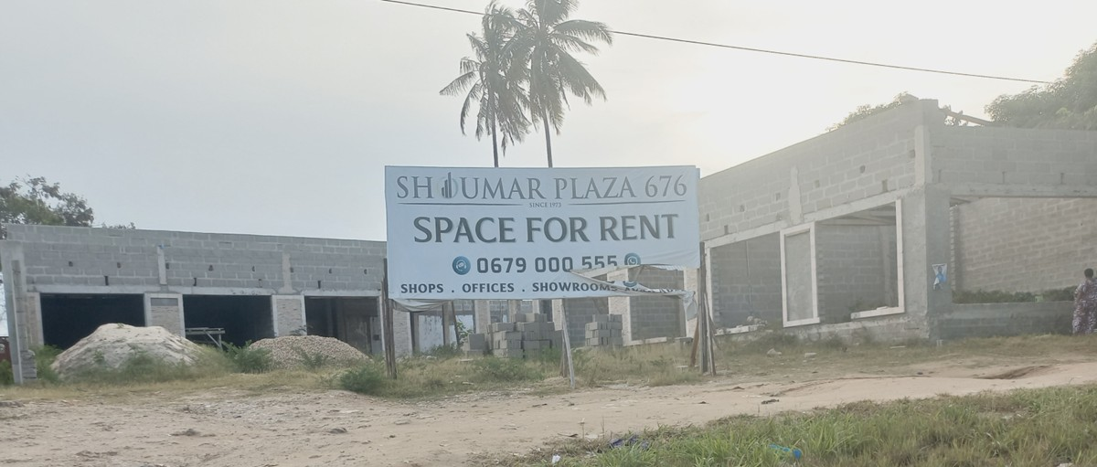
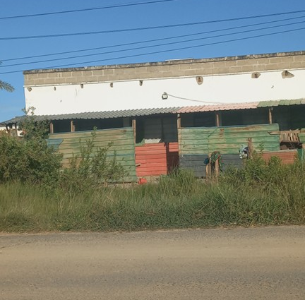
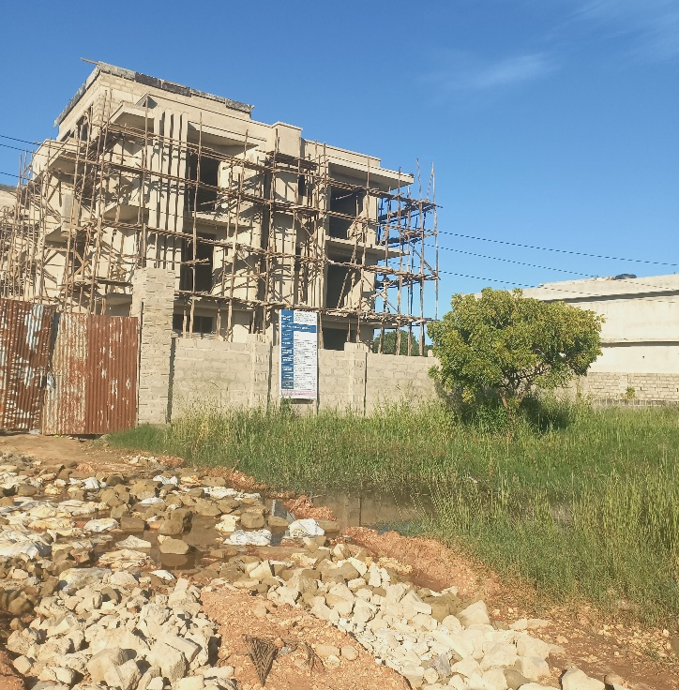
Speculative investment in Real Estate
Hope to attract “pre-letting” finance yet to materialize
Earmarked frames now converted into residences
Apartments under construction. Facing access issues, flooding for lack of drains

Slide 27
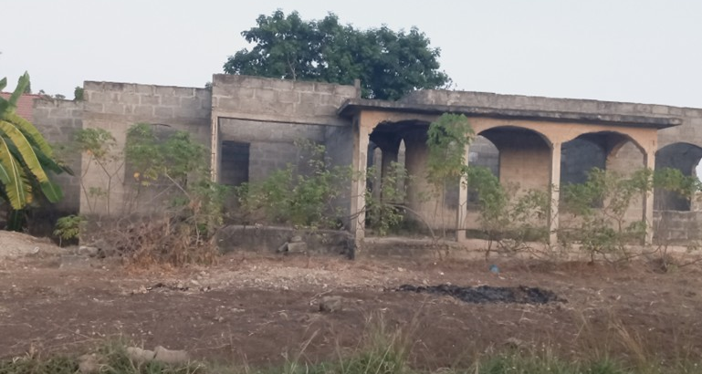
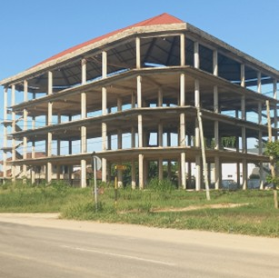
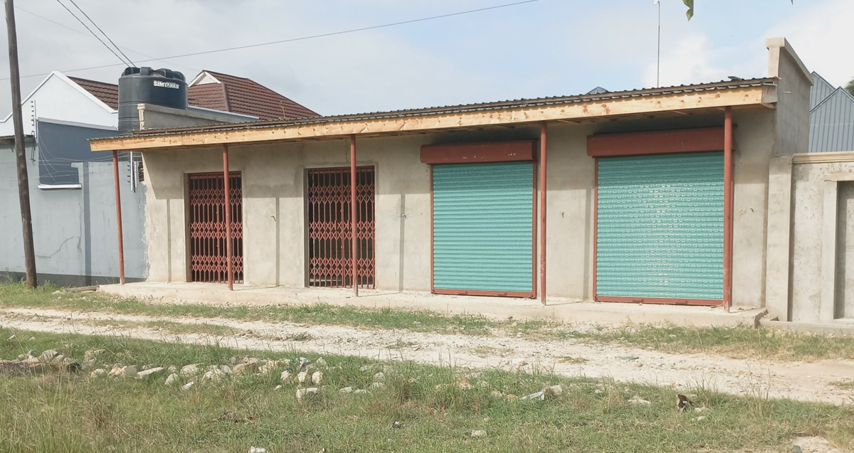
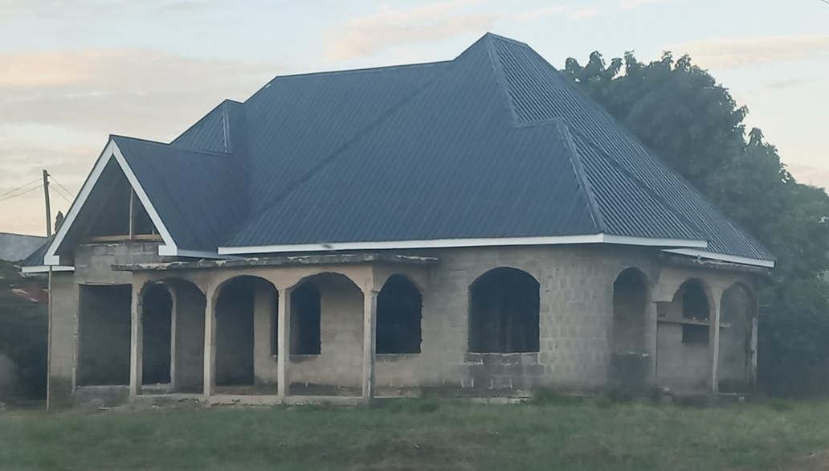
Stalled investments in Real Estate for years
Speculative commercial building under construction for over 10 years
Where are the financiers?
Roofed recently after stalling for over 20 years
Newly constructed “fames”, facing unmade, flooding road

Slide 28
Investing in informal unserviced land, risky
Over half of all urban land in Tanzania is informal (60%+) — no formal title, no planning approval, inadequate water, sanitation, roads, and electricity.
This situation represents decades of accumulated planning failure.
Situation repeats itself in many African cities especially the South of the Sahara
Investing in informal areas risky and property values may not be easily realised

Slide 29
Climate-Resilient Construction
Green building codes absent (to be enacted?)
Climate-resilient construction standards fragmented
Flooding affects large informal settlement areas, in flood plains, facing recurring losses
Construction sector not yet responding to climate risk.
Significant portions of Dar es Salaam, Mwanza, Tanga, and other cities are flood-prone.
Real estate investment in climate-exposed areas carries unquantifiable risk. (TICGL)

Slide 30
Financial Sector hesitant
Financial sector hesitant to finance large sections of real estate, unsure of investment viability
So, financing is mainly based on “Equity”, buildings taking ages to complete, in some cases deteriorating before completion; may lead to cutting down on standards, corruption
So, advantages like “leveraging”, that is, using other peoples’ money to build your real estate empire, are not readily available in many LDCs

Slide 31
High Cost of Construction and Maintenance
Cost of construction high relative to expected income (rent)
Tanzania imports most construction materials including steel, glass, specialist equipment, and finishing materials.
High import costs raise construction prices above affordable thresholds.
Weak planning and development control and lack or paucity of infrastructure increase the cost of investment in real estate
Local material manufacturing incentivised by FYDP IV but nascent.
The high cost also scares financiers

Slide 32
Fragmented Land Management, Registration & Institutional Overlaps
Multiple institutions with overlapping mandates: MLHHSD, LGAs, National Land Use Planning Commission, etc
Registration processes are paper-based, slow, and expensive.
Institutional overlaps create coordination failures and lengthy approval processes that discourage formal development.
LGAs, the planning authorities, not confident enough to execute their duties
Tug of war over land professionals: MLHHSD, PMORALG
Institutional overlaps and governance issues need solution

Slide 33
Digital Property Transaction Gap (90% Informal) TICGL
90% of property transactions are unrecorded or paper-based.
Opacity enables corruption, title fraud, and double registration;
Deters formal investment.
To move into Crowdfunding and Vision 2050, moving to digitalization is imperative

Slide 34
Anti-real estate investment campaigns
In the ongoing debates and education on financial literacy, mainly on social media, real estate has been getting a real beating
Examples include investing say TZS 50m/= in a rental property or in mutual funds eg UTT. In the latter case, you could get TZS 400,000 a month with no hassle
In the former case, you may get TZS 300,000 pm, also risking a lot of hassle with tenants, service providers, maintenance, vacancies, and many sleepless nights

Slide 35
Anti-real estate investment campaigns some headings from YuoTube
“My view is that buying and holding real estate is not an effective investment strategy in our current economic environment”
Warren Buffet: “Stocks beat Real Estate”
“People are admitting Real Estate Investing wasn’t worth it”
“Bought 22 rental units and now regret it”
Wealth Advisor: “Don’t Invest in Real Estate”
“Big losses, why you should never invest in Kenyan Rental Properties”

Slide 36
Potential Role of Real Estate Professionals
Work with other professionals eg Urban Land Use Planners to increase proportion of planned land as urban areas grow rapidly: by working with land owners to have their land planned (avoiding the contentious compulsory acquisition)
Private sector could play critical role in land use planning and servicing. Recall: Estates like Regent Estate in Dar were planned by the private sector
Campaign for more empowerment of local government authorities, especially urban areas to manage their affairs, weaning them from being spoon-fed by the central government

Slide 37
Potential Role of Real Estate Professionals
Work on facilities to finance urban infrastructure development, such as land-based financing, municipal bonds, Property Tax, development impact exactions etc to enable the improvement of the framework in which real estate operates in LDCs
Help to scale up registration and reliable access to property information, transactions

Slide 38
Concluding remarks
Real Estate is a popular medium of investment and a major form of individual and national wealth, despite its short comings
In these presentation, we have highlighted the many factors that add to the risks of investing in real estate in developing countries such as Tanzania
The risks discussed are not found in standard textbooks
It is therefore incumbent upon all professionals to work hard to reduce the risks that investors in real estate be they individual houseowners or large investors, to meet the Tanzania Vision 2050
TV2050 One of the Pillars: Affordable Housing and Human Settlements
Real estate professionals have a decisive role to play.

Slide 39
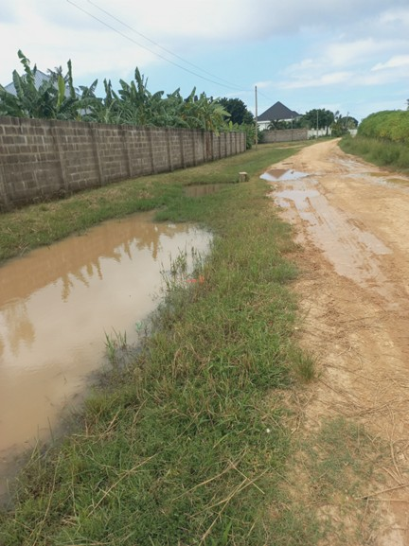
Thank you for your kind attention
Potential Flooding of real estate caused, in part, by an official drain left “hanging”

